Slide 1

STUDENT
LINK
A SMART CAMPUS PLATFORM FOR STUDENTS

Slide 2
Batch No: 23 Guide Name: Prof. A R Bindiya
Project Title: Student Link- A Smart campus platform for students
USN | Student Name
01JST19CS044 | Devothama G N
01JST19CS128 | Shaman B H
01JST19CS034 | Chandana Raju
01JST19CS042 | Darshan M

Slide 3
Contents
1. Introduction
2. Literature Review
3. Limitations of present work
4. Objectives of our work
5. Methodology
6. Work Plan
7. Conclusion

Slide 4
INTRODUCTION
01

Slide 5
The phrase"Student link” refers to academic institutions that seamlessly integrate next-generation technologies into their infrastructure for students
It increases more active interactions to encourage successful outcomes as today’s students are digital natives.
It allows for the creation of a "digitally connected" institution that can improve the on-campus experience, boost operational effectiveness, and deliver education that anyone can access right away.

Slide 6
The present approach does not seem user-friendly as all the features of the library, canteen, and student login data to name a few, are not available on a single platform
The existing system is definitely vulnerable as its encryption standards are comparatively low and there is a high concern of infringement of privacy of the student information
The existing portal is frequently out of service. This makes it uncertain and non-reliable. The existing system does not foster any kind of virtual interaction among the students and faculties

Slide 7
LITERATURE REVIEW
02

Slide 8
2. LITERATURE REVIEW
We have considered a few research papers that have been published in different timelines that have influenced our proposal on a large scale.
[01] ONLINE COLLEGE PORTAL SYSTEM-Tejaswini Chavan, Deb Dutta, Michelle Gomez and Alvino Vaz
Online College Portal system aims to improve the efficiency of college information management.
The administrator and students are two major functional requirements in the system. The Administrator will be given more access (enable/disable/ update) as compared to users. This paper assists in automating the existing manual system

Slide 9
[02] A Systematic review on Technologies and Applications in Smart Campus-YUCHEN ZHANG , CHRISTINE YIP, ERWAN LU AND ZHAO YANG DONG
This paper focuses on the systematic review of the technologies used in designing a smart campus that is mainly human-centered.
It records the important contemporary information and communication technologies and smart applications that can be used to make the campuses next generation smart.
[03] Creating student’s profile using blockchain technology-V. Juričić, M. Radošević and E. Fuzul
The most up to date university project is Blockcert, an open-source software developed by Media Lab at MIT university and the Learning Machine company

Slide 10
Blockert is currently based on Bitcoin blockchain, using unique identifiers to store the hash of a certificate, or to be more precisely bash of certificates.
This allows systems to store any kind of certificate or any kind of data to the blockchain because it is not storing document, but only its hash.
[04] Chatbot Development for Educational Institute-Dr.Vishwanath Karad
A College Enquiry Chatbot is developed using chatbot algorithm that is a python library that makes it easy to generate automated responses to a user's input.
This makes it easy for developers to create chat bots and automated conversations with the users. Some of the chatterbot tasks performed are Present some information and taking inputs

Slide 11
LIMITATIONS OF PRESENT WORK
03

Slide 12
The present approach does not seem user-friendly as all the features of the library, placement cell, and student login data to name a few, are not available on a single platform
The existing system is definitely vulnerable as its encryption standards are comparatively low and there is a high concern of infringement of privacy of the student information
The portal is frequently out of service. This makes it uncertain and non-reliable. The existing system does not foster any kind of virtual interaction among the students and faculty.

Slide 13
OBJECTIVES
04

Slide 14
Develop a culture of data creation and collection, analysis, application and availability.
Empowerment of interaction in productive ways among students, professors, other faculty, and the community by giving them the knowledge they need.
To create and maintain a digital campus —the next-generation campus that continually modernizes iteratively over time.

Slide 15
METHODOLOGY
05
Brief implementation of the project

Slide 16
5.1 BLOCKCHAIN SYSTEMS IN EDUCATION
As a very promising technology, blockchain has found high-quality applications in the field of education.
It will allow total independence of the students towards the institution and complete control over their data.
Data stored on the blockchain is permanently recorded and encrypted using cryptographic methods to ensure integrity, immutability through hash functions, and authenticity.
The most up-to-date university project is Blockcert, an open-source software that is currently based on the blockchain, using unique identifiers to store the hash of a certificate or to be the more precise bash of certificates. This allows systems to store any kind of certificate or any kind of data to the blockchain because it is not storing a document, but only its hash.

Slide 17
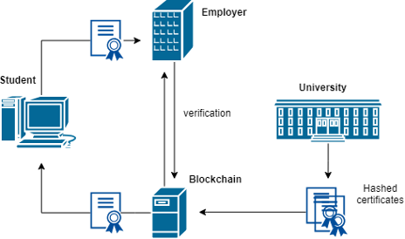
Components of a blockchain in an educational environment

Slide 18
5.2 SMART CONTRACTS
Smart contract is an executable program that is triggered when the system's state satisfies the contract's conditions or requirements.
Specifically, the diploma could be delivered to the student after the passing of all courses.
The smart contracts in education could be triggered after the fulfillment of all conditions required from the course, without any need for manual revision.
As an example, students would automatically receive a certificate upon acquiring a positive grade in the final exam, attending 80% of lectures and completing 25 exercises defined by the course.

Slide 19
It records the important contemporary information and communication technologies and smart applications that can be used to make the campuses next generation smart.
5.3 CHATBOT
TensorFlow is an end-to-end open source platform for machine learning. It has a comprehensive, flexible ecosystem of tools, libraries, and community resources that lets researchers push the state-of-the-art in ML, and gives developers the ability to easily build and deploy ML-powered applications.
TensorFlow provides a collection of workflows with intuitive, high-level APIs for both beginners and experts to create machine learning models in numerous languages.
Developers have the option to deploy models on a number of platforms such as on servers, in the cloud, on mobile and edge devices, in browsers, and on many

Slide 20
other JavaScript platforms. This enables developers to go from model building and training to deployment much more easily.
Tensorflow’s tokenizer assigns a unique token to each distinct word. and padding is done to get all the data to the same length so as to send it to an RNN layer. target variables are also encoded to decimal values.
Importing the Libraries and the Data
Pre-Processing the data
Input Length, Output Length and Vocabulary
Neural Network
Model Analysis
Testing

Slide 21
IMPLEMENTATION
04

Slide 22
MODULE 1 - STUDENT PROFILE USING BLOCKCHAIN
Many applications in smart campus require the overlapping and interactions over multiple domains, which promotes the technology fusion towards the common smart development goal. The concept and scope of the domain used in the “Student Profile” module is introduced below.
The blockchain technology is used in our proposal to ensure the protection and reliability of data storage
TECH STACK
1. Ethereum - Ganache CLI
2. Web3
3. Solidity
4. IPFS
5. Truffle

Slide 23
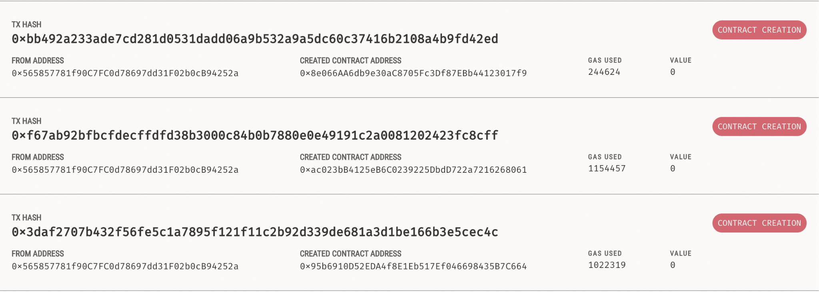
Ganache and Ganache-cli
Ganache is used for setting up a personal Ethereum Blockchain for testing your Solidity contracts.
Ganache is used in our project in order to deploy the smart contracts of the student profile.
We created two smart contracts SimpleStorage.sol and Education Contract.sol and deployed it to the local Blockchain provided by Ganache.

Slide 24
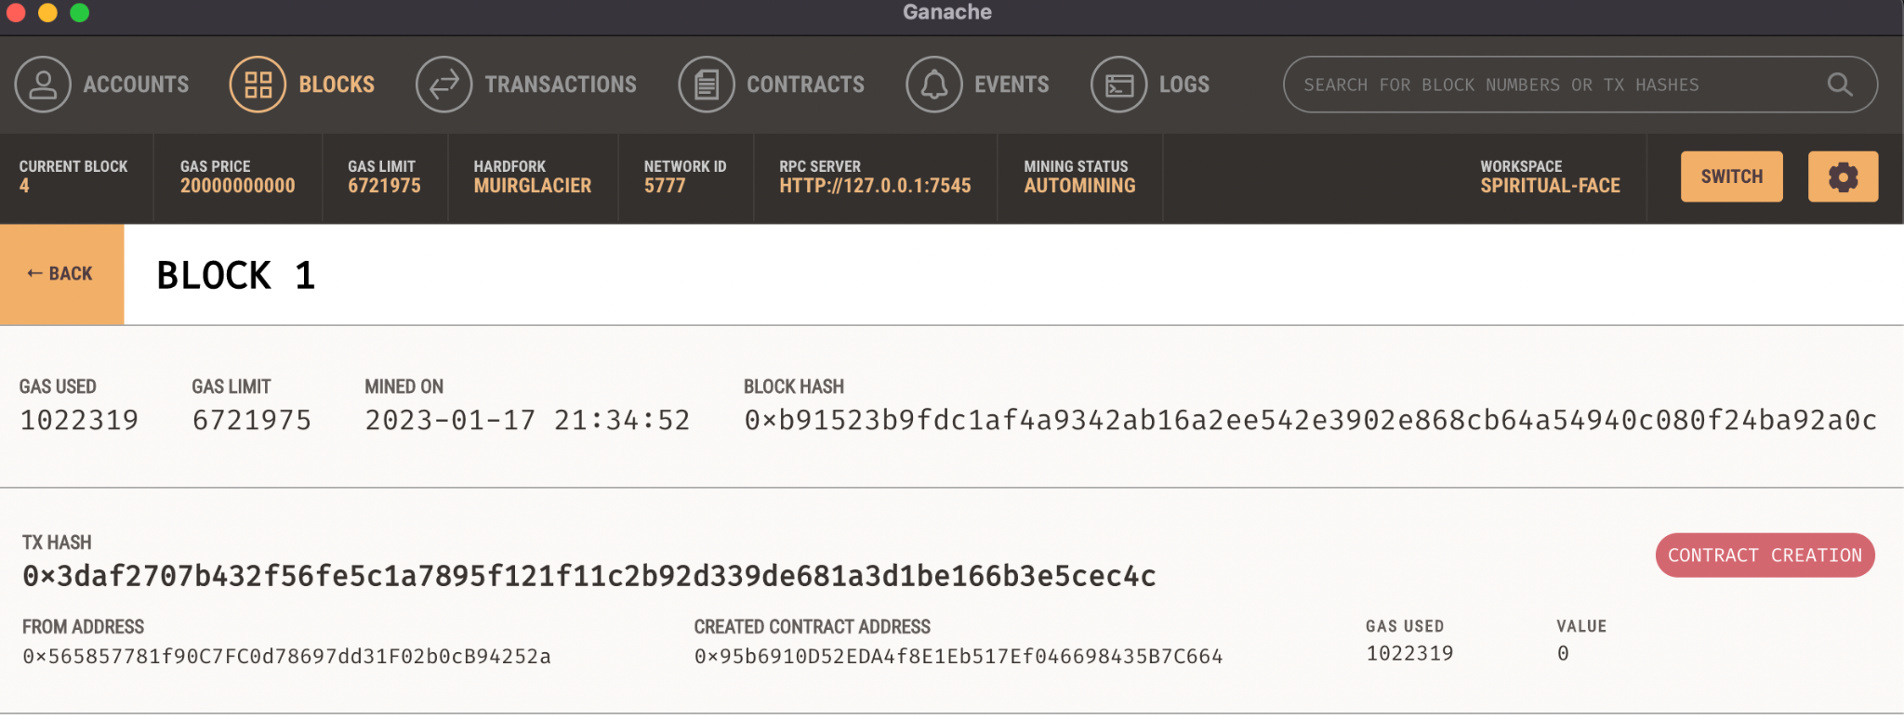

Slide 25
These two contracts will create two Blocks in Blockchain.
Truffle
Truffle is a one-stop solution for building DApps: Compiling Contracts, Deploying Contracts, Injecting it into a web app, Creating front-end for DApps and Testing.
It is a Development Environment, Testing Framework and Asset pipeline for Ethereum Blockchains.
MetaMask
MetaMask is an easy-to-use browser plugin (for Google-Chrome, Firefox and Brave browser), that provides a graphical user interface to make Ethereum transactions.
It allows you to run Ethereum DApps on your browser without running a full Ethereum node on your system. Basically, MetaMask acts as a bridge between Ethereum Blockchain(Ganache) and the browser

Slide 26
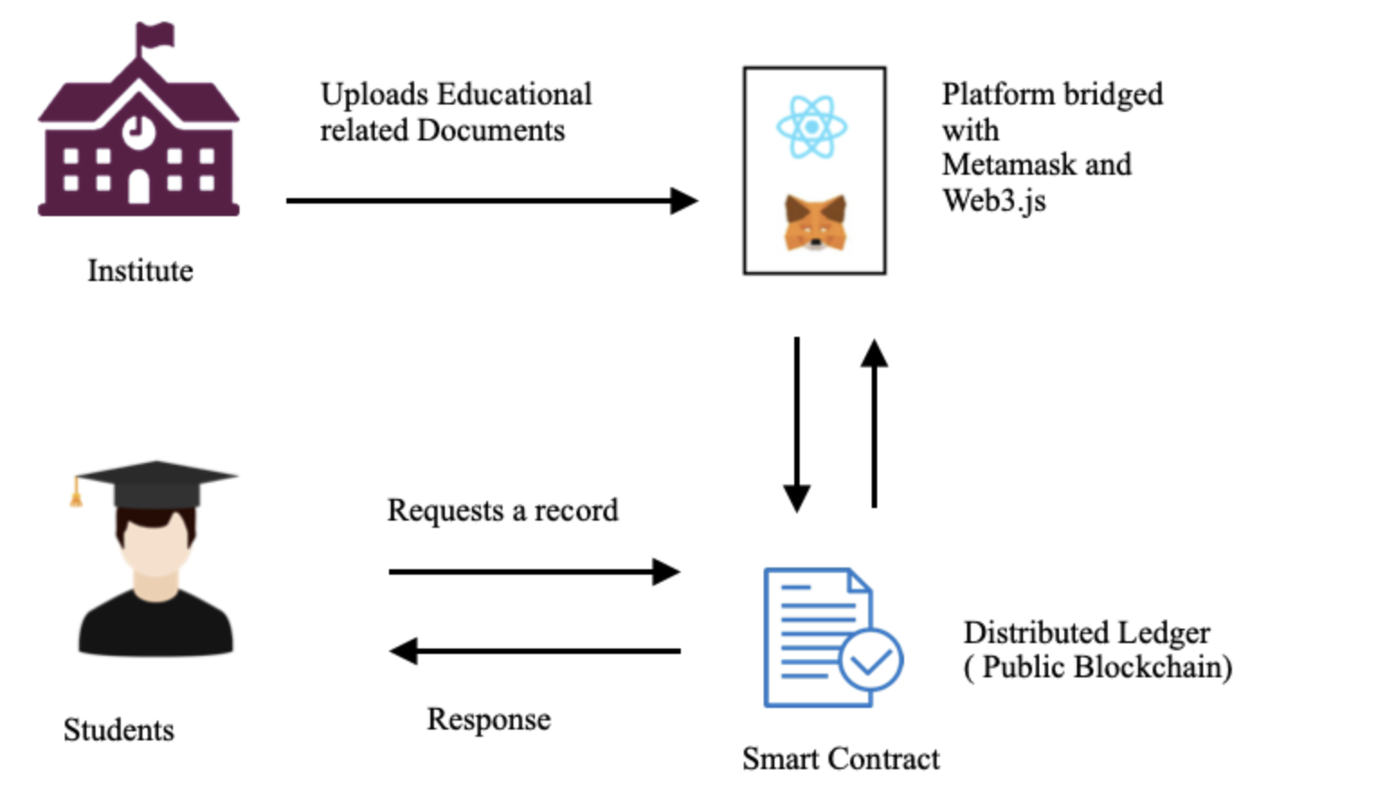
The user interface used to interact with the user is developed the using the following
1. ReactJS - Web language 2. Bootstrap - Framework
The login interface for student and institute and the record dashboard page are developed using the same.

Slide 27
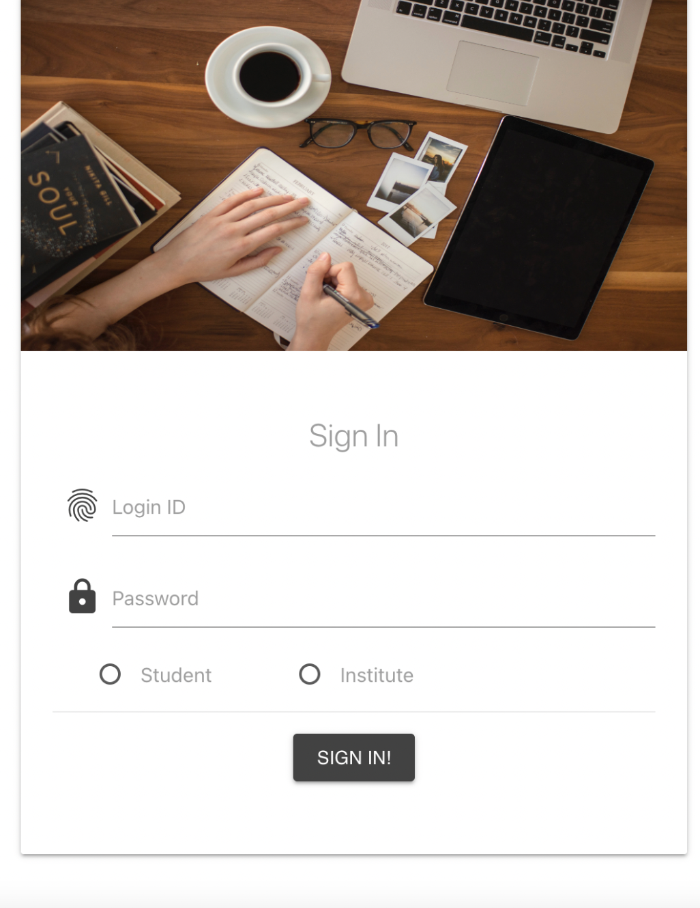
MODULE 1
Student Profile Using Blockchain

Slide 28
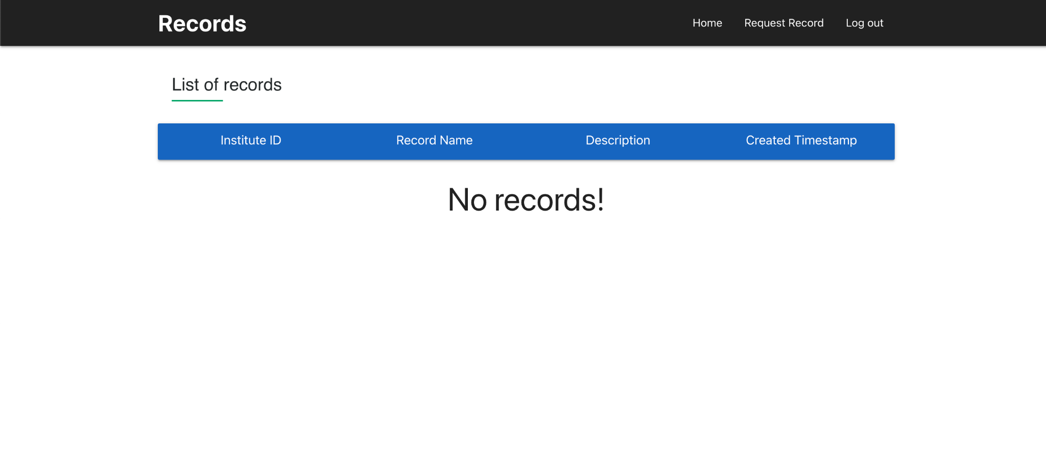

Slide 29
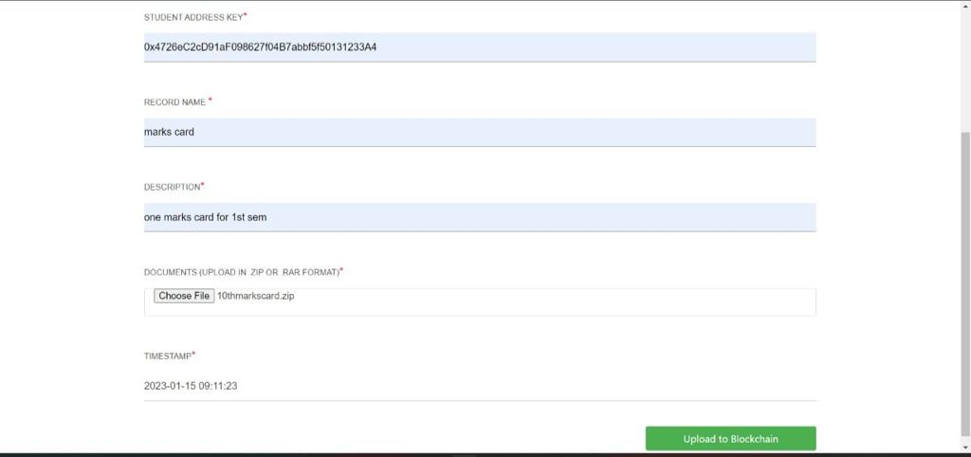

Slide 30
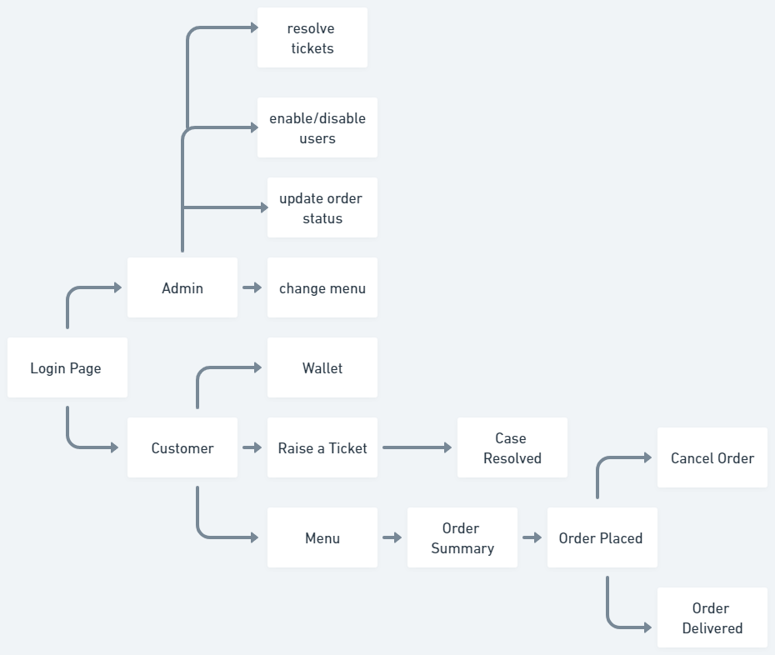

Slide 31
MODULE 2 - CANTEEN MANAGEMENT AND FOOD DELIVERY
This application is efficient in maintaining customer’s details and can easily perform operations on customer’s records and also works to handle the information of the products available in a canteen. It also saves a lot of time and reduces the chances of any errors that were possible with the earlier system. This application also reduces the workload of the canteens.
XAMPP
SQL
PHP

Slide 32
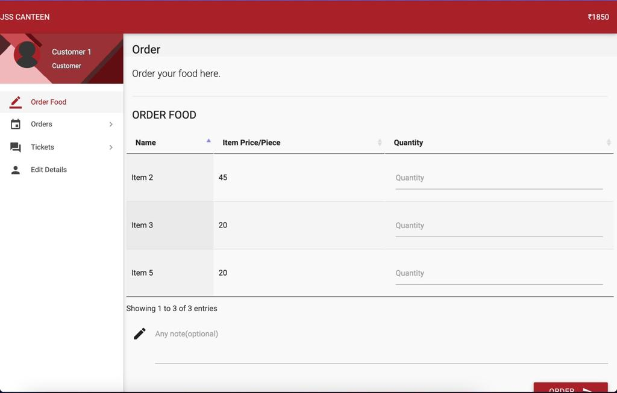
MODULE 2
JSS CANTEEN

Slide 33
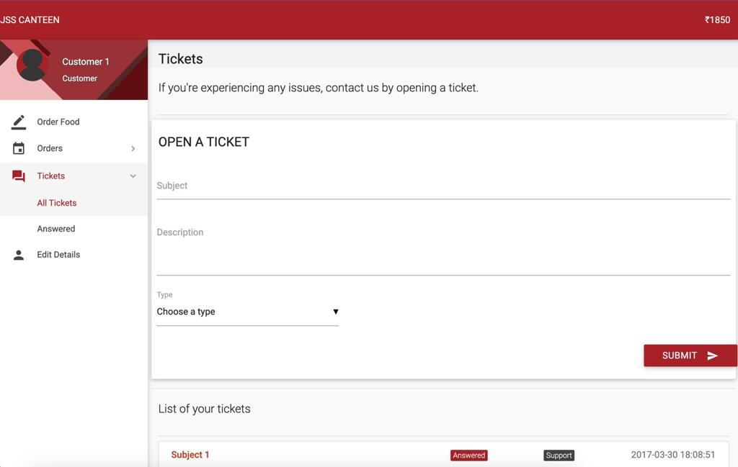

Slide 34
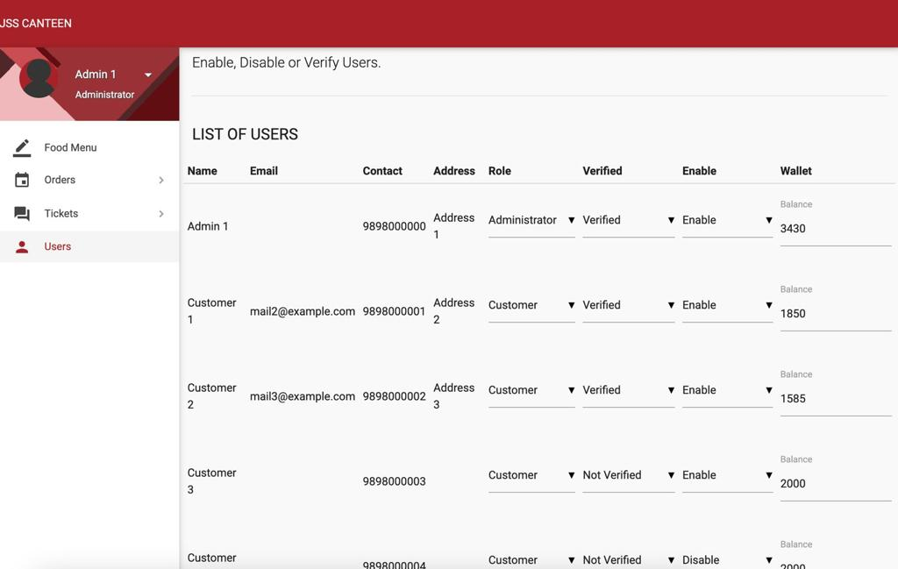

Slide 35
MODULE 3 - SJCE LIBRARY PORTAL
This system will provide the much needed information repository that the libraries need to be efficiently managed, which contains the relationships among admin, user, and members.
TECH STACK
XAMPP
SQL
PHP

Slide 36
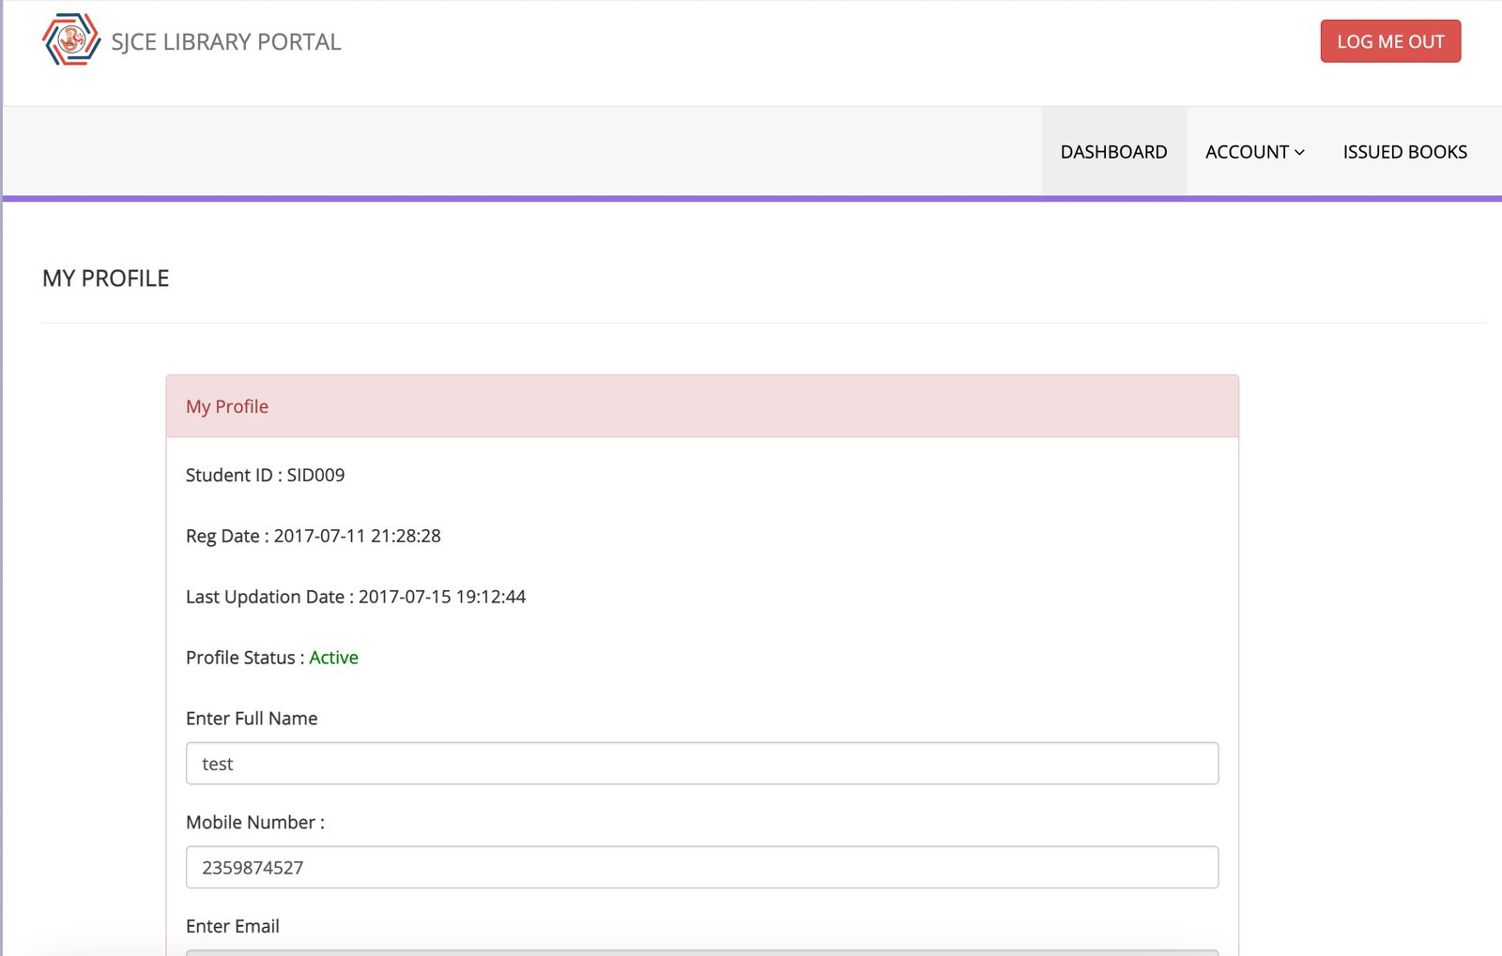
MODULE 3
SJCE
LIBRARY
PORTAL

Slide 37
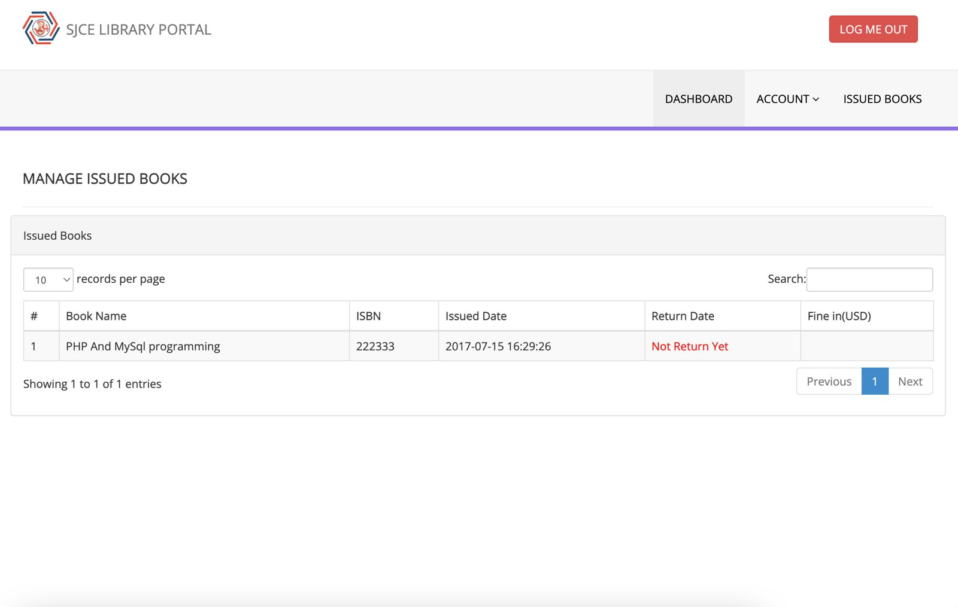

Slide 38
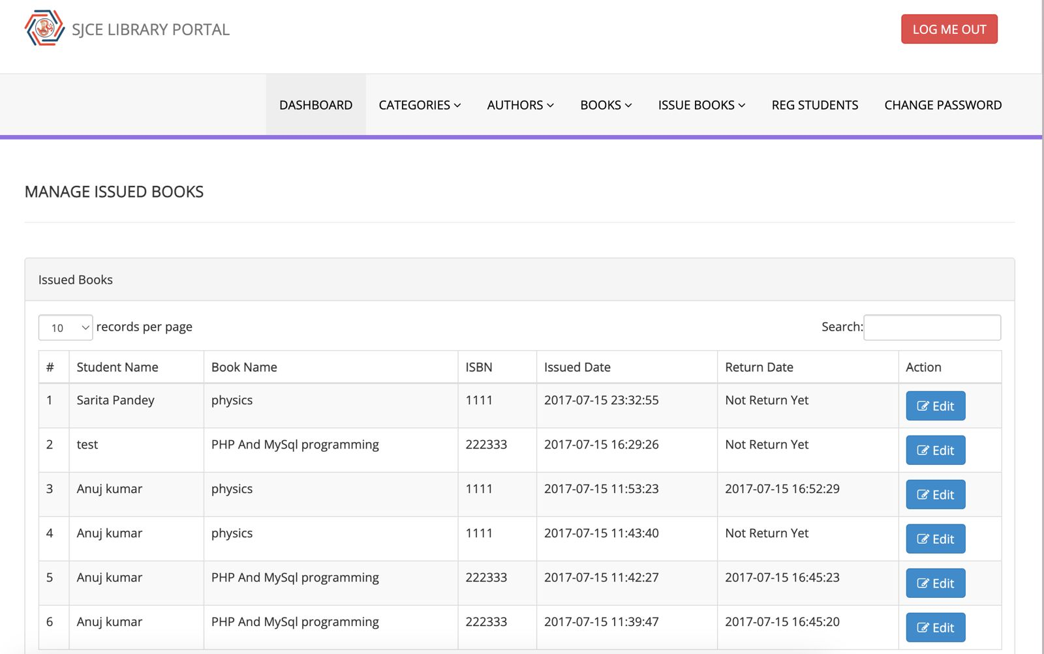

Slide 39
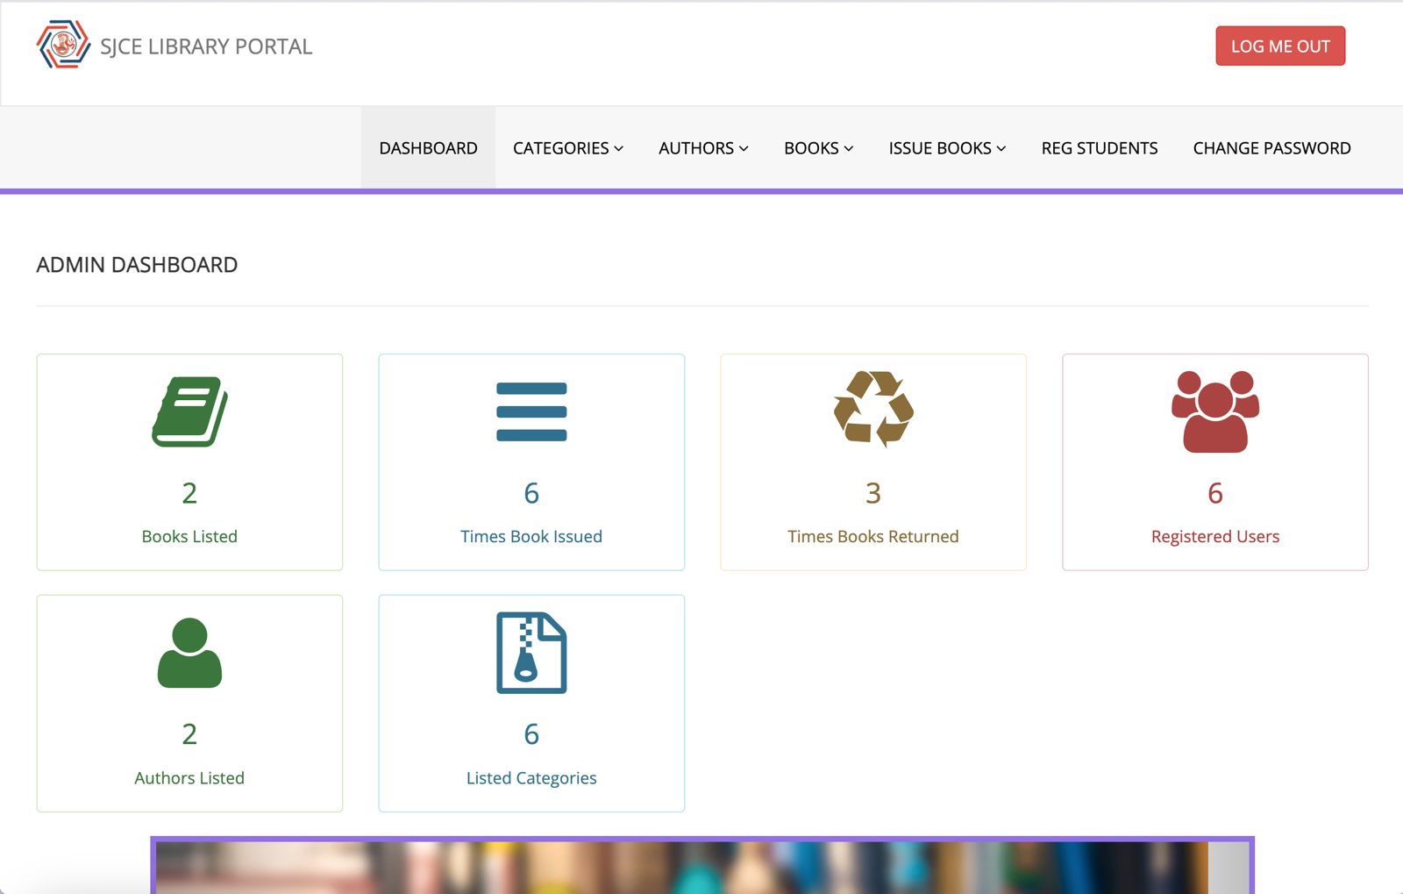

Slide 40
MODULE 4 - SJCE Chatbot
KnowBot is an AI and web based interactive college enquiry chatbot. The College Enquiry Chatbot will, among other things, engage in friendly interactions, respond to course and college information, provide a link to the active clubs website and answer frequently asked queries. This project focuses on developing a chatbot that students can use to get their questions answered quickly from the college website.
TECH STACK
Artificial Intelligence
Machine Learning
Natural Language Processing
PHP

Slide 41
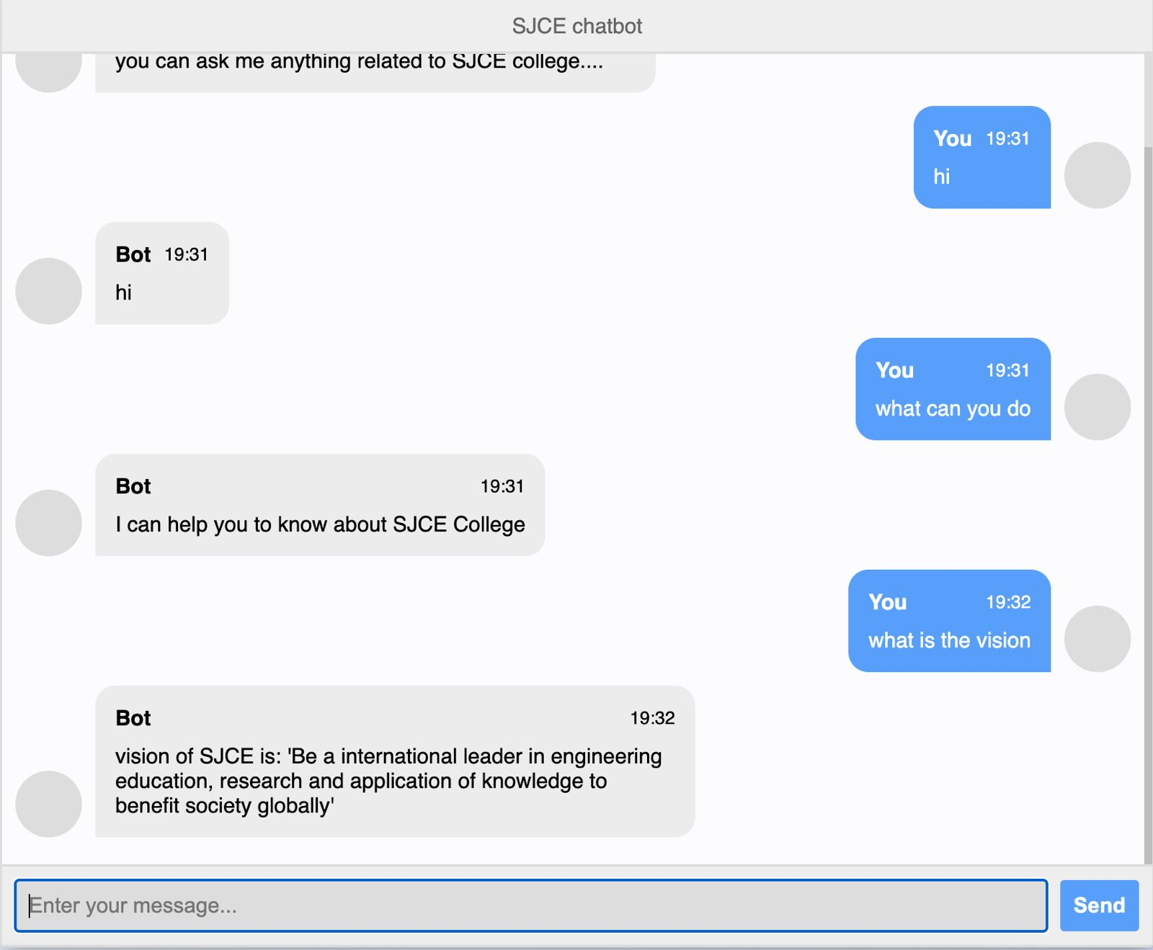
MODULE 4
SJCE Chatbot

Slide 42
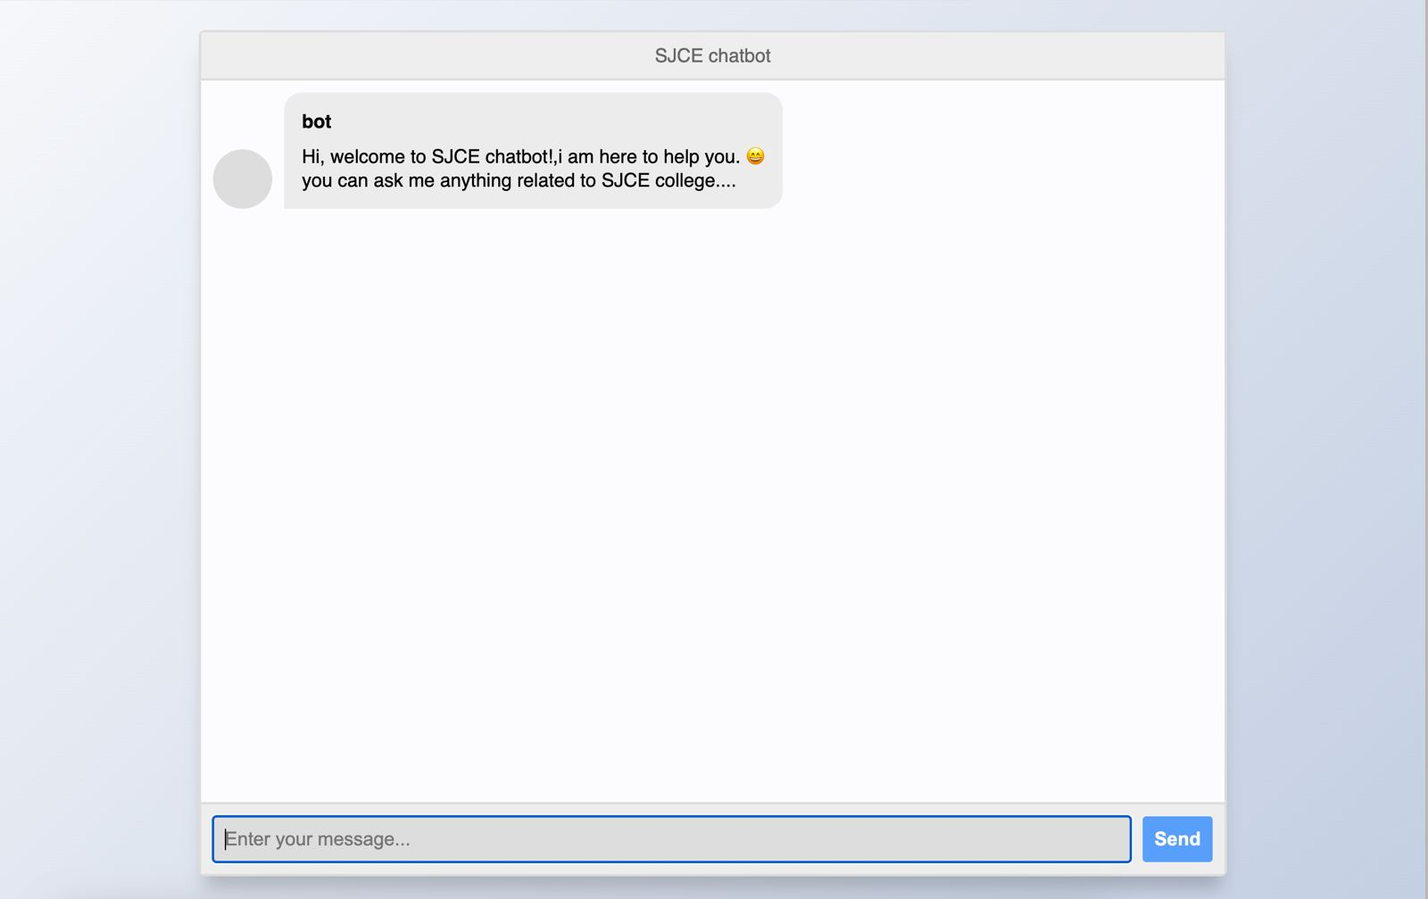

Slide 43
WORKPLAN
06

Slide 44
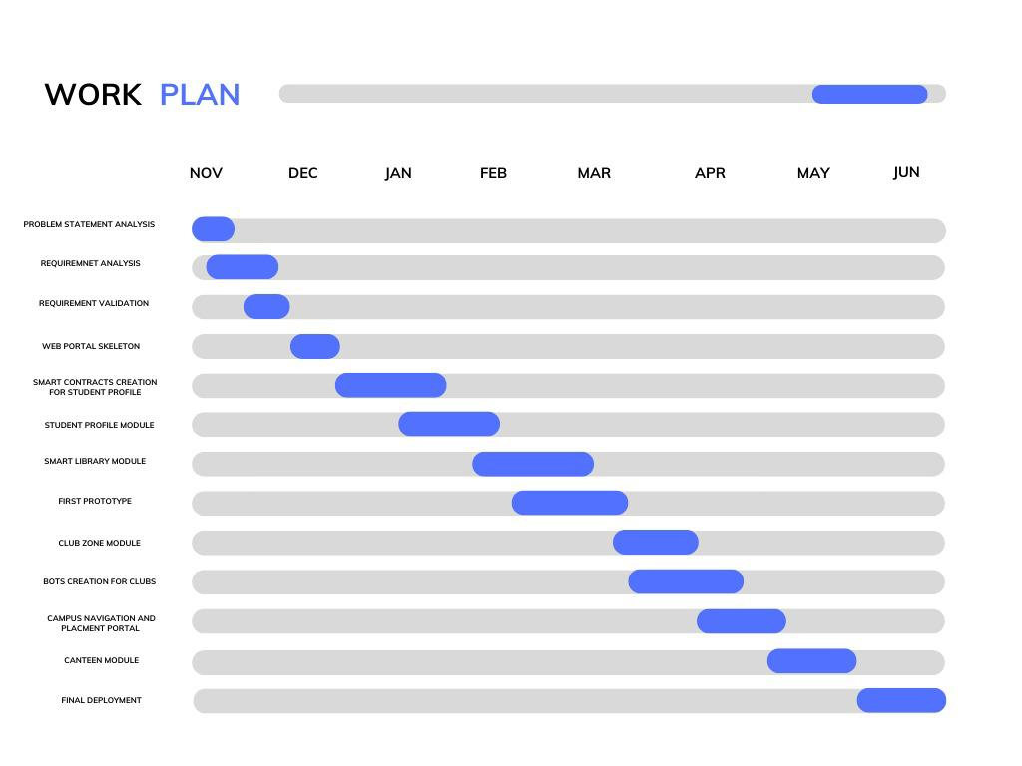

Slide 45
CONCLUSION
07

Slide 46
A smart campus can help improve three important factors: experience, efficiency, and education
It can help reshape how we interact on campus and it can be the proper way for the transformation that will enable campuses to address the future of learning and work while improving the campus experience
Our project mainly aims at digitizing crucial practices on the campus and also connecting all parts of the campus on a single portal where the availability of resources is of utmost concern.
Imagine if these technologies communicated in a manner that effortlessly initiated positive outcomes through intuitive and intelligent interactions.

Slide 47
Thank You!

